Slide 1

Architecture
KT44502 DISTRIBUTED SYSTEM
Semester 1 2022/2023

Slide 2

Content
Parallel Architecture
Flynn’s Taxonomy
Memory Organisation

Slide 3
Parallel Architecture
Why is a 32-bit computer faster than an 8-bit? Parallelism.
32-bit computer can do it in one step, handling each of the 4 bytes within the 32-bit numbers in parallel.
That’s why the history of computing has seen us move from 8- to 16-, 32-, and now 64-bit architectures.
The total amount of benefit we’ll see from this kind of parallelism has its limits, though, which is why we’re unlikely to see 128-bit computers soon.

Slide 4
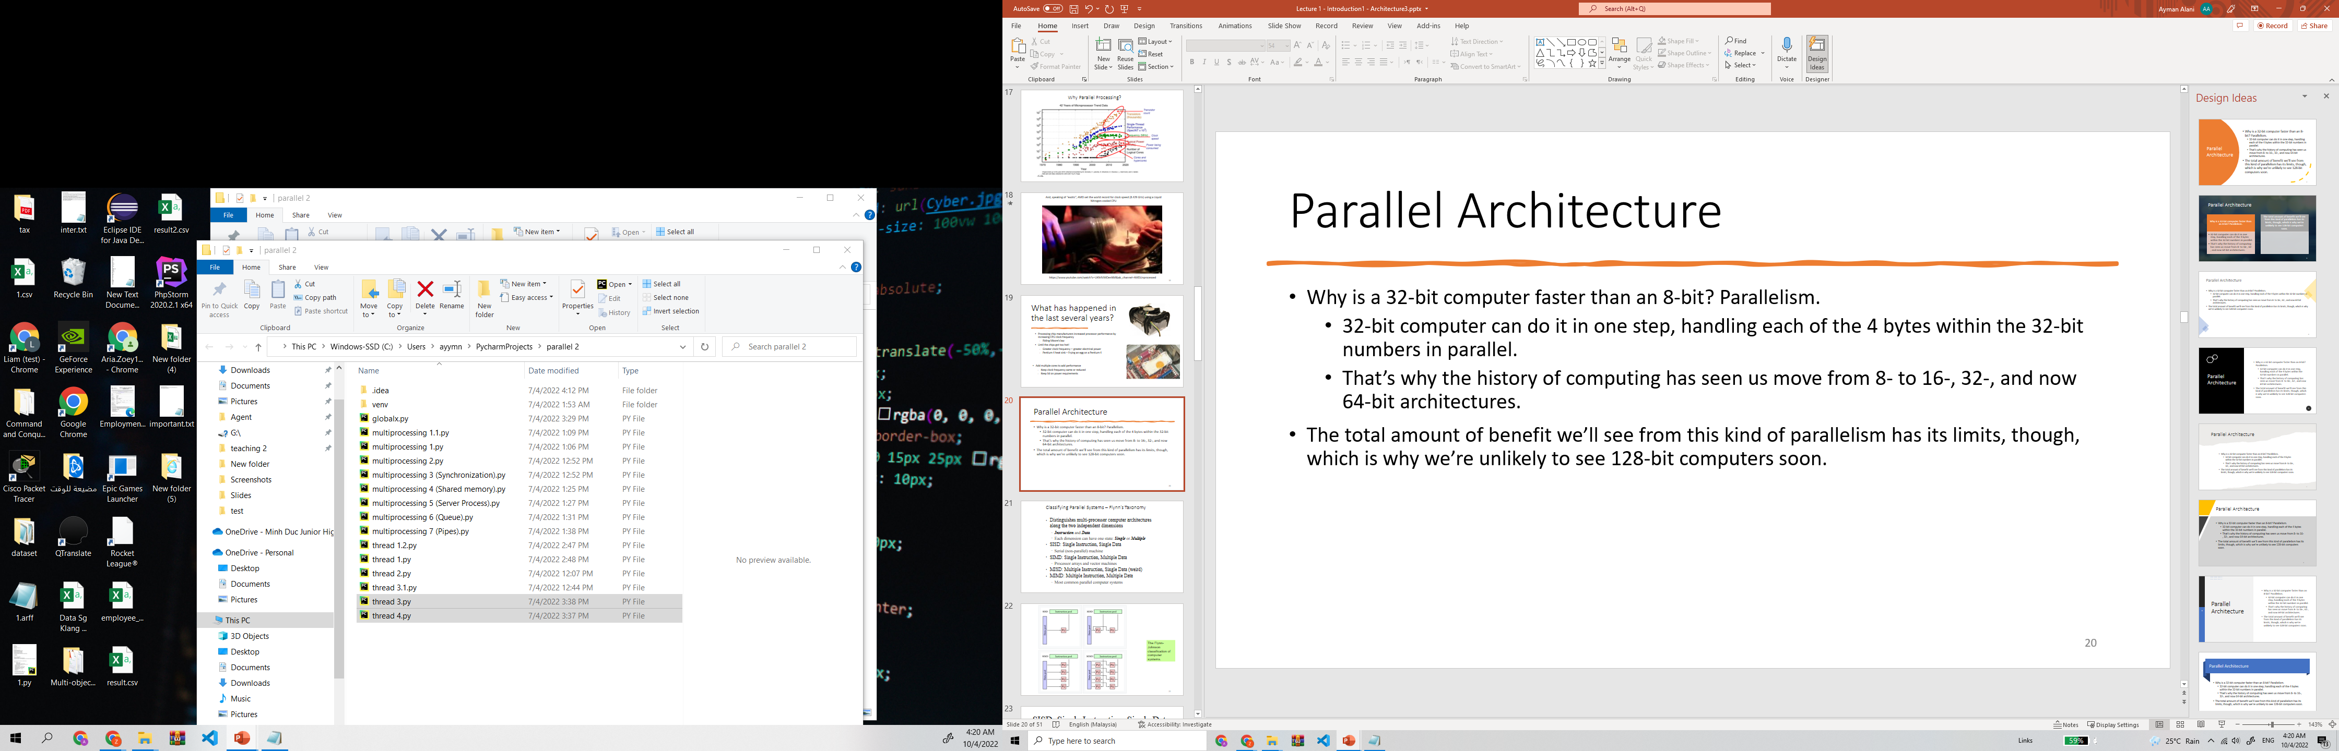
Classifying Parallel Systems – Flynn’s Taxonomy
•
Distinguishes multi-processor computer architectures along the two independent dimensions
– Instruction and Data
Each dimension can have one state: Single or Multiple
–
•
SISD: Single Instruction, Single Data
– Serial (non-parallel) machine
•
SIMD: Single Instruction, Multiple Data
– Processor arrays and vector machines
MISD: Multiple Instruction, Single Data (weird)
MIMD: Multiple Instruction, Multiple Data
– Most common parallel computer systems

Slide 5
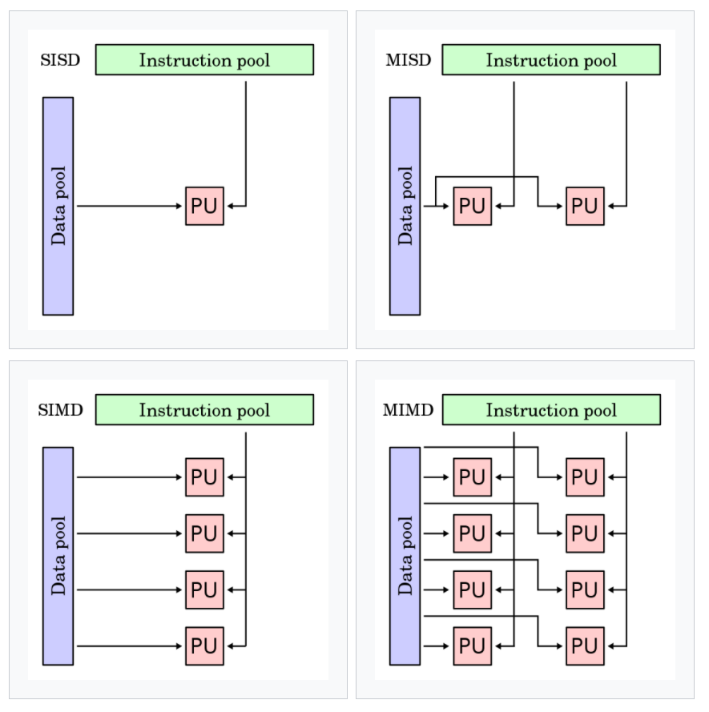
The Flynn-Johnson classification of computer systems.

Slide 6
SISD: Single Instruction, Single Data
The SISD computing system is a uniprocessor machine. It executes a single instruction that operates on a single data stream.
In SISD, machine instructions are processed sequentially.
In a clock cycle, the CPU executes the following operations:
Fetch: The CPU fetches the data and instructions from a memory area, which is called a register.
Decode: The CPU decodes the instructions.
Execute: The instruction is carried out on the data. The result of the operation is stored in another register

Slide 7
SISD: Single Instruction, Single Data
The main elements of these architectures are:
Central memory unit: This is used to store both instructions and program data.
CPU: This is used to get the instruction and/or data from the memory unit, which decodes the instructions and sequentially implements them.
I/O system: This refers to the input data and output data of the program.

Slide 8
MISD: Multiple instruction, single data
In this model, n processors, each with their own control unit, share a single memory unit.
In each clock cycle, the data received from the memory is processed by all processors simultaneously, each in accordance with the instructions received from its control unit.
The parallelism (instruction-level parallelism) is obtained by performing several operations on the same piece of data.
MISD computers are more of an intellectual exercise than a practical configuration.

Slide 9
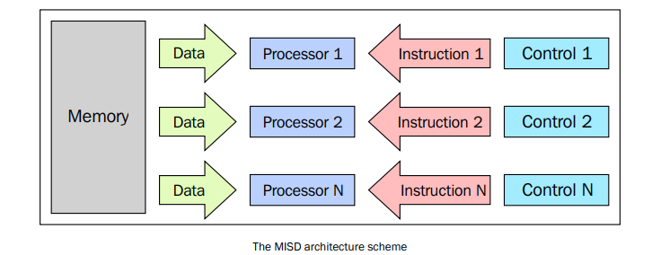
MISD: Multiple instruction, single data

Slide 10
SIMD: Single instruction, multiple data
A SIMD computer consists of n identical processors, each with its own local memory, where it is possible to store data.
The processors work simultaneously on each step and execute the same instruction, but on different data elements.
The algorithms for these computers are relatively easy to design, analyze, and implement.

Slide 11
SIMD: Single instruction, multiple data
Numerous problems covering a wide range of applications can be solved by parallel algorithms on SIMD computers.
Another interesting feature is that the algorithms for these computers are relatively easy to design, analyze, and implement.
The limit is that only the problems that can be divided into a number of subproblems can be addressed with the SIMD computer.

Slide 12
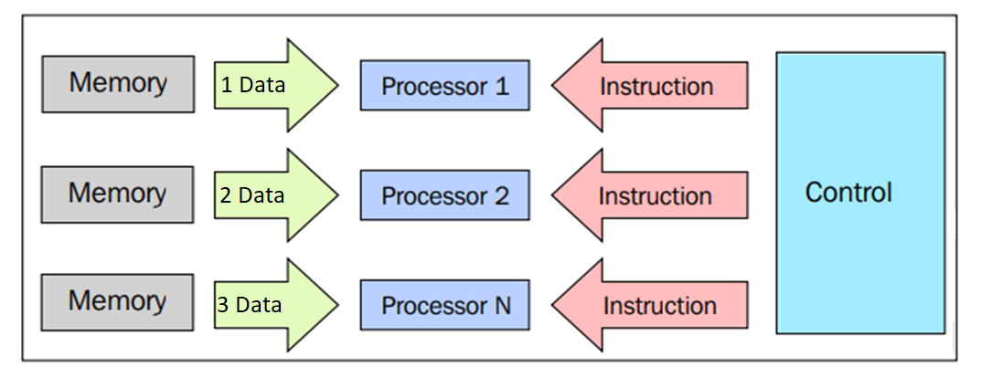
SIMD: Single instruction, multiple data

Slide 13
MIMD: Multiple instruction, multiple data
A MIMD computer consists of n processors, n instruction streams, and n data streams.
Each processor has its own control unit and local memory.
Each processor operates under the control of a flow of instructions issued by its own control unit.
Processors can run different programs on different data, solving subproblems that are different and can be a part of a single larger problem.

Slide 14
MIMD: Multiple instruction, multiple data
MIMD, architecture is achieved with the help of the parallelism level with threads and/or processes. This also means that the processors usually operate asynchronously.
The computers in this class are used to solve those problems that do not have a regular structure that is required by the model SIMD.
MIMD architecture is applied to many PCs, supercomputers, and computer networks.

Slide 15
Memory Organisation
Memory organization: the way in which the data is accessed.
The main problem that must be overcome to make the response time of the memory compatible with the speed of the processor.
When the processor starts transferring data, the memory will remain occupied for the entire time of the memory cycle.
MIMD can be divided into machines that have a shared memory and those that have a distributed memory.

Slide 16
Memory Organisation
MIMD
Distributed Memory
Cluster
Shared Memory
NUMA
UMA
MPP
NoRMA
COMA

Slide 17
Shared Memory
The memory is the same for all processors.
The synchronization is made possible by controlling the access of processors to the shared memory.
A shared memory location must not be changed from a task while another task accesses it.
Sharing data is fast.
The memory access in shared memory systems is as follows:
Classified as Uniform Memory Access (UMA).
Non-Uniform Memory Access (NUMA).
No Remote Memory Access (NoRMA).
Cache-Only Memory Architecture (COMA).

Slide 18
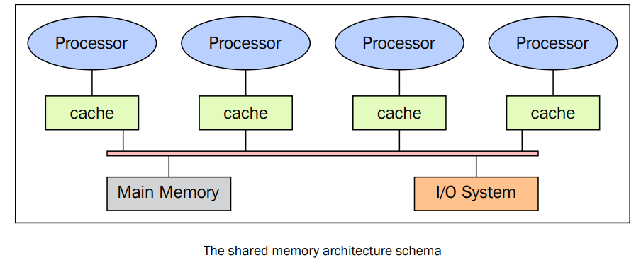
Shared Memory

Slide 19
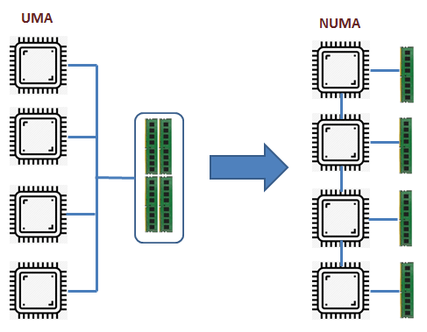
Uniform Memory Access (UMA)
The fundamental characteristic of this system is the access time to the memory that is constant for each processor and for any area of memory.
Also called as symmetric multiprocessor (SMP).
Simple to implement, but hard to scalable.
Memory access is slow.

Slide 20
Non-Uniform Memory Access (NUMA)
The memory area is divided into a high-speed access area that is assigned to each processor.
A common area for the data exchange, with slower access.
Processors may have local cache memories.
The collection of local memories (LM) forms a global address space accessible by all processors.
Easy to scalable, but complex to develop.
Memory access is faster than UMA memory

Slide 21
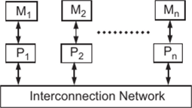
No Remote Memory Access (NoRMA)
The memory is physically distributed among the processors (local memory).
All local memories are private and can only access the local processor.
The communication between the processors is the interconnection network to other processors used for exchanging messages, which is known as the message-passing protocol.

Slide 22
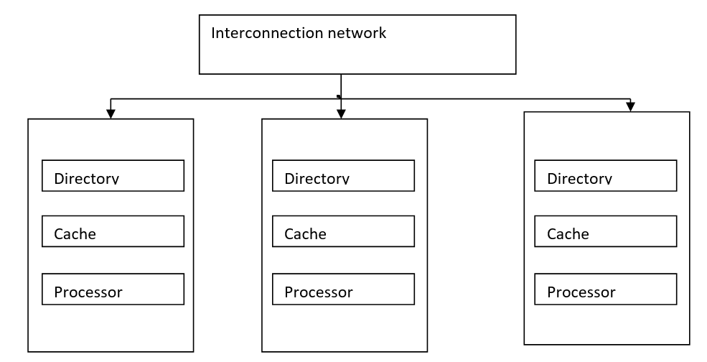
Cache-Only Memory Architecture (COMA):
These systems are equipped with only cached memories.
This architecture removes duplicates and keeps only the cached memories; the memory is physically distributed among the processor.
All local memories are private and can only access the local processor.
The communication between the processors is also through the message-passing protocol.

Slide 23
Memory Organisation
MIMD
Distributed Memory
Cluster
Shared Memory
NUMA
UMA
MPP
NoRMA
COMA

Slide 24
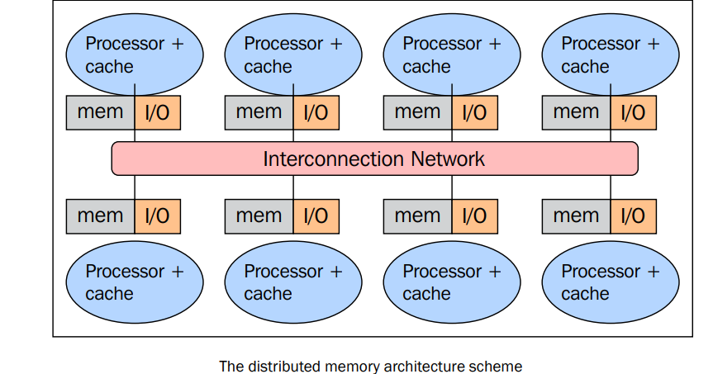
Distributed Memory

Slide 25
Distributed Memory Factures
Memory is physically distributed between processors; each local memory is directly accessible only by its processor.
Synchronization is achieved by moving data between processors (communication).
The subdivision of data in the local memories affects the performance of the machine.
The message-passing protocol is used.

Slide 26
Advantages of Distributed Memory Architecture
No conflicts at the level of the communication bus or switch.
No intrinsic limit to the number of processors
The size of the system is only limited by the network used to connect the processors.
No problems of cache coherency

Slide 27
Disadvantages of Distributed Memory Architecture
The communication between processors is more difficult to implement.
If a processor requires data in the memory of another processor, the two processors should necessarily exchange message via the message-passing protocol.
To build and send a message one processor to another takes time.
Any processor should be stopped in order to manage the messages received from other processors.
A program designed to work on a distributed memory machine must be organized.

Slide 28

Massively Parallel Processing (MPP)
MPP is a single computer with many networked processors.
Each CPU contains its own memory and copy of the operating system and application
The fastest computers in the world are based on these architectures.
Example systems: Earth Simulator, Blue Gene, ASCI White, ASCI Red, and ASCI Purple and Red Storm.
IBM Blue

Slide 29
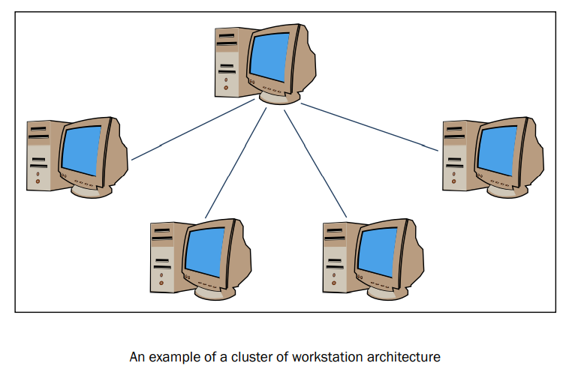
Workstation Clusters
Workstation Clusters are processing systems that based on classical computers that are connected by communication networks.
A single computing takes part in the cluster.
The cluster is fully transparent.

Slide 30

Thank You
Next: Parallel Computer Architecture

